Slide 1
Why and When will Leaders of Developing County Negotiate South-North Preferential Trade Agreements?
Lucie Lu
Department of Political Science
September 19, 2018
Notes:
Hi

Slide 2
Research Question
Empirical puzzle: Preferential trade agreements (hereafter PTAs) negotiation between South Africa and the EU in 1994
Research question: Why and when will leaders in the developing country negotiate South-North preferential trade agreements with provisions of economic reforms?
Why important?
South-North PTA is rapidly growing.
Its power imbalances reflect political costs and motives.
Contributes to a larger debate: do PTA change leaders’ behaviours, or leader self-select into the treaty?

Slide 3
Context and Rationale
Two themes in the literatures:
Effects vs. Causes of PTAs
What are the gaps in the literature?
Treat PTA as unit of analysis
Focus on the deepest and costly subcategory of PTAs.
Overlook a key actor
Literature only looked at median voters¹, interest groups², and private sectors³.
Strategic interactions between leader and opposition.
1. Mansfield & Milner, 2012; Mansfield, Milner, & Rosendorff, 2002.
2. Grossman and Helpman, 1995.
3. Staiger & Tabellini, 1999.

Slide 4
Argument
A leader negotiates PTAs after political crisis to punish the opponents’ past transgression. PTA negotiation is a deliberate choice that a leader makes to commit to the binding and stringent policy reforms to rearrange the domestic power structures.

Slide 5
Theory
Economic reform as a political strategy
Non-crisis Political Crisis Post-crisis
Repress
Leader
Rent
Cooperate
Opposition
Defect
Opposition:
threatening demands
Leader: survives
Repress more
Leader
Retract rent
Economic Reforms

Slide 6
Theory (II)
(II) Why negotiating a PTA with major liberal powers?
PTA as a signal: opposition’s cooperation
PTA as a mechanism to redistribute rent from trade:
Disloyal opponents Loyal opponents
Reform
Reform
Side-payment
Framework:
Political crisis Economic reforms
PTA

Slide 7
Research Design
Hypothesis:
Negative shocks to a leader's security increase the probability of PTA negotiations.
(Hypothetical Treatment)
Shock to Leader’s Security
+
South-North PTA Negotiation
Research Design:
Compares the likelihoods of the South-North PTAs negotiation in:
Leaders with shocks to security
Leaders without shocks to security

Slide 8
Research Design (II)
Measure the Security of a Leader:
1) A leader's security before he starts his tenure at time 0 (Svolik 2012);
leader’s relation to the past
2) The security of the regime at time t (political effectiveness score in the state fragility index).
political effectiveness score > 0.
Identify Leaders with Shocks to Security (Hypothetical Treatment):
1) Type 1: a leader has a negative shock to security at time 1.
2) Type 2: a leader has a negative shock to security at time t.

Slide 9
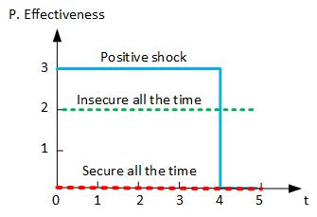
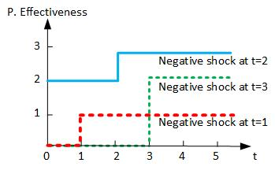
Who are Treated?
Control group Treated group

Slide 10
Examples in Datasets
Unit of analysis: Leader-Year
Country | Year | Leader | Regime | R.T. Past | P. Eff | PTA Nego.
Albania | 1997 | Fatas | Dem. | NA | 1 | 0
Albania | 1998 | Fatas | Dem. | NA | 2 | 0
Algeria | 1995 | Zeroual | Dict. | Regime | 2 | 0
Algeria | 1996 | Zeroual | Dict. | Regime | 2 | 1
Algeria | 1997 | Zeroual | Dict. | Regime | 2 | 0
Algeria | 1998 | Zeroual | Dict. | Regime | 2 | 0
Algeria | 1999 | Zeroual | Dict. | Regime | 2 | 0
Unit of analysis: Leader
Country | Leader | Tenure | Regime | R.T. Past | P. Eff | Shock(Z) | PTA Nego.
Albania | Fatas | 2 | Dem. | NA | shock_t | 1 | 0
Algeria | Zeroual | 5 | Dict. | Regime | shock_t1 | 1 | 1

Slide 11
Research Design (III)
Unit of analysis: leader
The dataset covers 286 leaders in 62 developing countries from 1995 to 2015.
Exclude liberal democracies
Exclude leaders whose tenure is less than one year
Dependent Variable: South-North PTA negotiation
Independent Variable: Negative Shocks to Security
Matching on the Covariates:
Regime Type (V-Dem’s Electoral Democracy Index)
Human Rights Conditions (PTS Score)
Regime Duration (Archigos, 2016)
GDP per capita (World Bank)
Confounding Variables in the OLS Model:
Leaders’ tenure (Archigos, 2016)
Negative Economic Growth (World Bank)

Slide 12
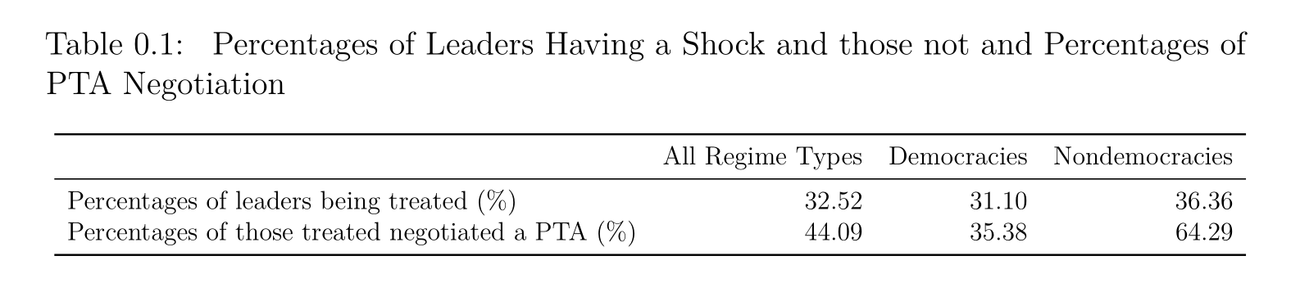
Empirical Findings: Data Description
There are 93 events out of 286 total observations.

Slide 13
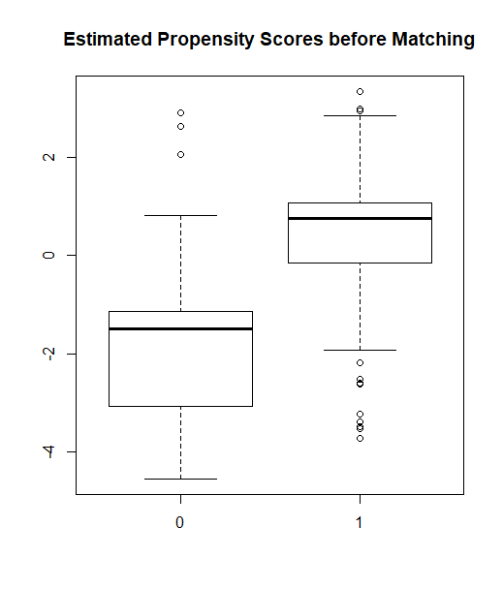
Empirical Findings: Propensity Score Before Matching

Slide 14
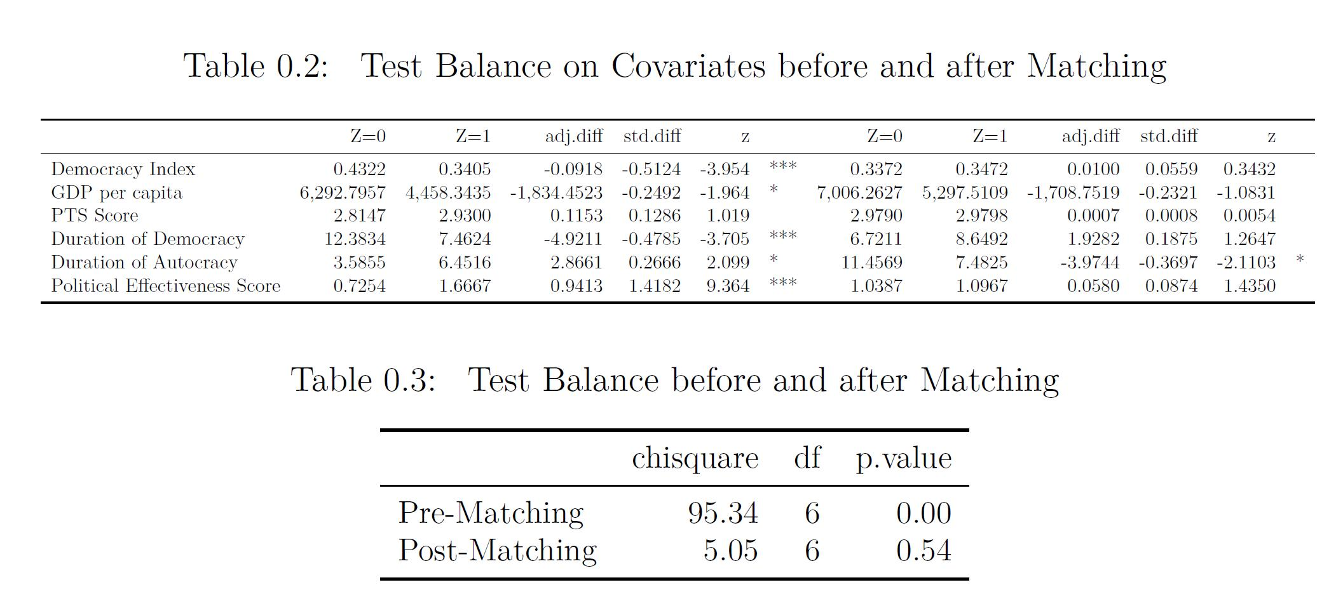
Empirical Findings: Propensity Score After Matching

Slide 15
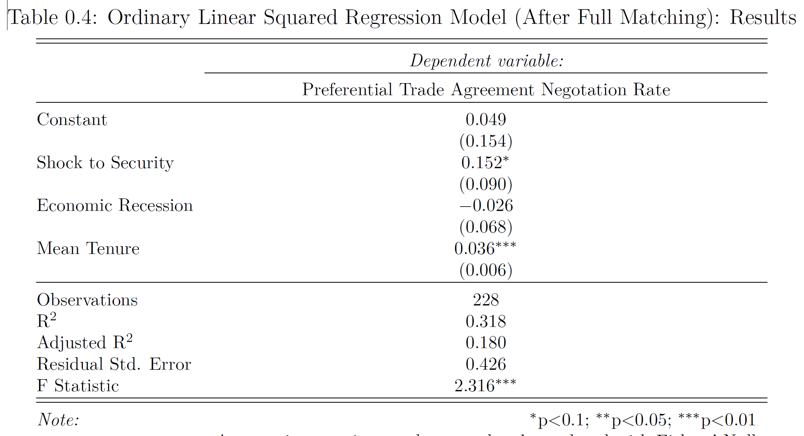
Empirical Findings: Treatment Effect After Matching

Slide 16
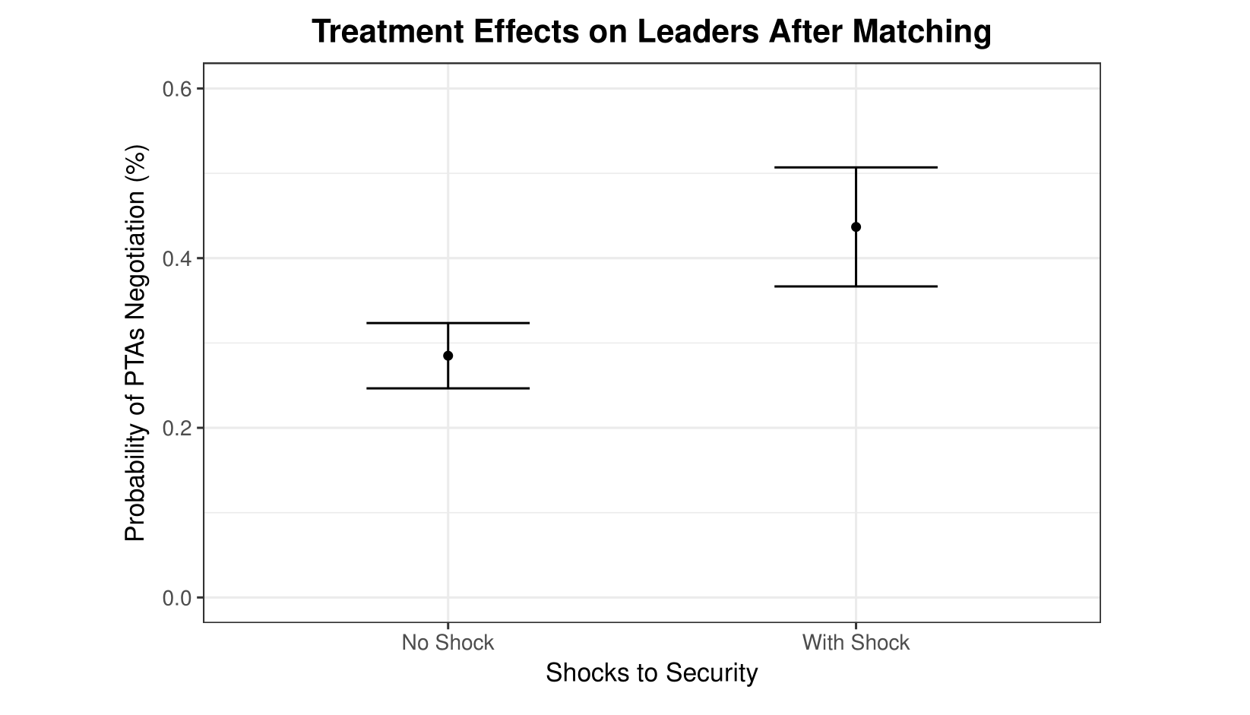
Empirical Findings: Treatment Effect After Matching

Slide 17
Conclusion
My hypothesis is empirically supported.
When leaders experience a political crisis, they are more likely to negotiate a South-North preferential trade agreement with the provision of economic reforms.
Future Work:
Explore whether PTA negotiation helps leaders to conduct economic reforms
Use a multilevel analysis
Notes:
hello

Slide 18
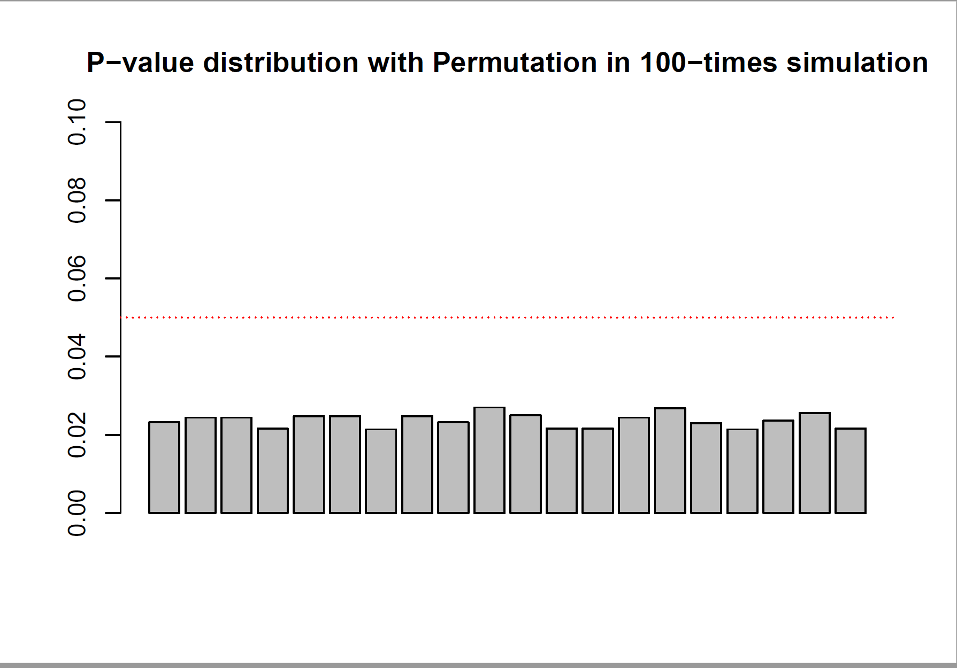
Appendix
Notes:
hello

Slide 19
References
Baccini, L., & Urpelainen, J. (2014). International Institutions and Domestic Politics: Can Preferential Trading Agreements Help Leaders Promote Economic Reform? The Journal of Politics, 76(1), 195–214. https://doi.org/10.1017/S0022381613001278
Bagwell, K., & Staiger, R. W. (1998). Will Preferential Agreements Undermine the Multilateral Trading System? The Economic Journal, 108(449), 1162–1182. https://doi.org/10.1111/1468-0297.00336
Baldwin, R. E. (2012). A Domino Theory of Regionalism. In G. Hufbauer & K. Suominen (Eds.), The Economics of Free Trade. Volume 2. (pp. 416–439). Elgar Research Collection. The International Library of Critical Writings in Economics, vol. 262. Cheltenham, U.K. and Northampton, Mass.: Elgar.
Bilal, S., & Laporte, G. (2004). How David Prepared to Talk to Goliath? South Africa’s experience of negotiating trade with the EU.
Dür, A., Baccini, L., & Elsig, M. (2014). The Design of International Trade Agreements: Introducing a New Dataset. The Review of International Organizations, 9(3), 353–375. https://doi.org/10.1007/s11558-013-9179-8
Grossman, G. M., & Helpman, E. (1995). The Politics of Free-Trade Agreements. The American Economic Review, 85(4), 667–690.
Kuran, T. (1991). Now out of Never: The Element of Surprise in the East European Revolution of 1989. World Politics, 44(01), 7–48. https://doi.org/10.2307/2010422
Mansfield, E. D., & Milner, H. V. (2012). Votes, Vetoes, and the Political Economy of International Trade Agreements. Princeton University Press. Retrieved from https://muse-jhu-edu.proxy2.library.illinois.edu/book/30505
Mansfield, E. D., Milner, H. V., & Rosendorff, B. P. (2002). Why Democracies Cooperate More: Electoral Control and International Trade Agreements. International Organization, 56(3), 477–513.
Mansfield, E. D., & Reinhardt, E. (2003). Multilateral Determinants of Regionalism: The Effects of GATT/WTO on the Formation of Preferential Trading Arrangements. International Organization, 57(4), 829–862.
Regan, P. M., & Henderson, E. A. (2002). Democracy, threats and political repression in developing countries: Are democracies internally less violent? Third World Quarterly, 23(1), 119–136. https://doi.org/10.1080/01436590220108207
Rodrik, D. (1992). The Rush to Free Trade in the Developing World: Why So Late? Why Now? Will it Last? (No. w3947). Cambridge, MA: National Bureau of Economic Research. https://doi.org/10.3386/w3947
Schamis, H. E. (1999). Distributional Coalitions and the Politics of Economic Reform in Latin America. World Politics, 51(2), 236–268. https://doi.org/10.1017/S0043887100008182
Staiger, R. W., & Tabellini, G. (1999). Do Gatt Rules Help Governments Make Domestic Commitments? Economics & Politics, 11(2), 109–144. https://doi.org/10.1111/1468-0343.00055
Wintrobe, R. (1998). The political economy of dictatorship /. Cambridge, UK ; Cambridge University Press,.

